Slide 1

Île-à-la-Crosse Class Action Settlements
September 29, 2025

Slide 2
Warning
Some of the information and discussions in this presentation may cause distress or
re-traumatization for some Survivors or Intergenerational Survivors.
Hope for Wellness Help Line
Hope for Wellness Help Line offers immediate mental health counselling and crisis intervention to all Indigenous peoples across Canada.
Phone and chat counselling is available in English, French, Cree, Ojibway and Inuktitut on request.
Call the toll-free Help Line at 1-855-242-3310, 24 hours a day, 7 days a week, or use the chat box on their website.

Slide 3
What is the Class Action About?
The class action was originally started in 2005 by a group of Survivors looking to obtain compensation for the harms that were suffered by the former students who attended the Île-à-la-Crosse School (the Mission School) any time before it closed in 1976, and by their family members
The claim is made against the Governments of Canada and Saskatchewan for their roles in the creation and operations of the Mission School
The harms for which compensation are sought include loss of language, culture, Indigenous identity, family and community disruption, inadequate education, mental abuse, physical abuse, sexual abuse, and intergenerational harms
Current Class Counsel (Sotos LLP and Goldblatt Partners LLP) took over the action in 2022, and started to push it forward to be approved as a class action by the Court of King’s Bench

Slide 4
What is the Class Action About?
There is a Survivors’ Steering Committee who are making the decisions about how the Class Action is being prosecuted and who provide the instructions to Class Counsel. They also keep the Class Members updated about the litigation to the extent that they are able to share information (some information is confidential in the litigation, and can’t be shared)
This includes the 6 named Plaintiffs in the Class Action and other representatives from the community
The Métis Nation-Saskatchewan has been providing support to the Steering Committee and financial support for the Class Action

Slide 5
The Class Action Settlements
There are two separate Agreements in Principle to Settle the Class Action – one for each of Canada and Saskatchewan
There will be formal Settlement Agreements that are now being finalized that will set out all the details of the Settlements, including how the Settlement Funds will be used, and how claims will be made and decided
The Settlement Agreements have to be approved by the Court of King’s Bench before they are final and enforceable
The court dates for the Settlements’ approval are January 29 and 30, 2026 in Saskatoon

Slide 6
The Class Action Settlements
How will I find out the Details of the Settlements?
Once the Settlements are finalized, there will be formal Notices that will be published and made available to Class Members and the Community in English, French, Michif, Plains Cree, and Dene.
The Steering Committee and Class Counsel will hold information sessions – one in Saskatoon, one in Northern Saskatchewan, and one online, to explain about the Settlements’ terms, once they are completed. There will be a video recording of the online information that people will be able to access online. There will be opportunities at all information sessions to ask questions of Class Counsel.

Slide 7

The Saskatchewan Settlement
$40,200,000 to be paid by the Government of Saskatchewan as full and final settlement of all the claims made against it in the Class Action.
The Plaintiffs/Survivors’ Steering Committee will decide how the settlement money is to be allocated, and then ask the Court to approve that allocation
This is called a “Distribution Plan”

Slide 8
The Saskatchewan Settlement
The first priority for these funds is to provide compensation for Survivors who were the victims of physical and sexual abuse
There will be different levels of compensation depending on the severity of the abuse that the Survivor suffered

Slide 9
The second priority will be to provide a “top up” to the Experience Payments for students who were boarders at the Mission School.
The costs of administering the Saskatchewan Settlement, including the costs of deciding eligibility for abuse compensation, will be paid out of the Settlement Funds.
Legal Fees to Class Counsel will also be paid out of the Settlement Fund. The legal fees have to be approved by the Court before they can be paid out.
This graphic is an estimate of the Settlement Fund allocation.
The Saskatchewan Settlement

Slide 10
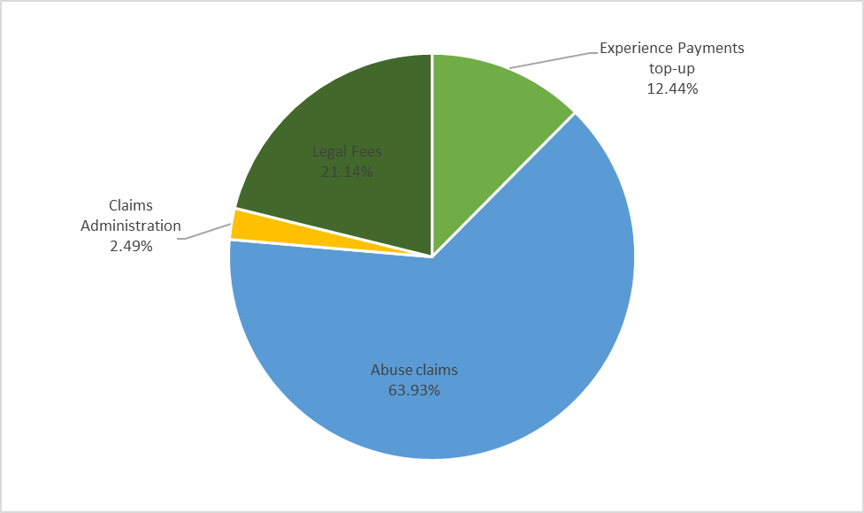

Slide 11

The Canada Settlement
The Settlement with Canada has three separate elements:
$27,355,000 for “Experience Payments” to be paid to all former students at the Mission School (both day students and boarders)
$10,000 for less than 5 years of attendance at the School
$15,000 for 5 years or more of attendance at the School

Slide 12
The Canada Settlement
The Settlement with Canada has three separate parts:
$10,000,000 for a “Legacy Trust” to be used to fund projects to address healing, wellness, education, language, culture and commemoration.
The Trust will be run by a non-profit corporation with a Trustee Committee who will decide how to allocate the Trust Funds to meet the objectives of the Legacy Trust.

Slide 14
The Canada Settlement
The Settlement with Canada has three separate parts:
$5,000,000 for Claims Administration
This covers the costs of deciding who is a Survivor Class Member (former students at the Mission School), and deciding if those Survivor Class Members are entitled to an Experience Payment of $10,000 or $15,000.
It also covers the costs of providing Notice about this Settlement to the Class.

Slide 16
QUESTIONS?
Sotos LLP
416.977.0007 (T)
416.977.0717 (F)
info@sotosllp.com
Goldblatt Partners LLP
647.381.8500 (T)
416.591.7333 (F)
tyang@goldblattpartners.com

